Slide 1




Data-Limited Fisheries Toolkit
Evaluating management strategies for data-limited fish species
How do Management Procedures work?
Lecture 1d, May 2017
Tom Carruthers & Adrian Hordyk .
Nicolas Gutierrez

Slide 2
Agenda
Anatomy of an MP
Schematic examples of MPs

Slide 3
1. Anatomy of an MP
Any algorithm that uses data to make a management recommendation
Data
Algorithm
Recommendation

Slide 4
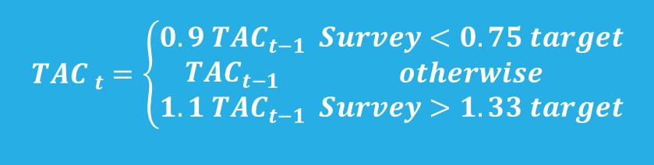
1. Anatomy of an MP
Simple MP seeking a target survey level:
Annual survey
Survey target
$${TAC }_{t}=\left\{\begin{aligned}{0.9 TAC}_{t−1} \\ {TAC}_{t−1} \\ {1.1 TAC}_{t−1}\end{aligned} \begin{matrix}Survey<0.75 target \\ otherwise \\ Survey>1.33 target\end{matrix}\right.$$
TAC_{t}

Slide 5
1. Anatomy of an MP
Statistical catch-at-age assessment with control rule
Catch, effort, size data, life-history parameters etc.
Data filtering > assessment model fitting > adjusted data weighting > final fitting > projections > 40-10 control rule > typical adjustment by managers
TAC_{t}

Slide 6
Overview of data-limited MPs
TAC
Notes:
Data-limited?!

Slide 7
Overview of data-limited MPs
FMSY
FMSY
FMSY
Current stock size
Current stock size
Current stock size
TAC

Slide 8
Overview of data-limited MPs
Kimura 1981
Unfished
stock size
Depletion
Depletion
Depletion
Depletion
Depletion
FMSY
FMSY
FMSY
Current stock size
Current stock size
Current stock size
DBSRA
SPSRA
TAC
Notes:
Stock reduction analyses

Slide 9
Overview of data-limited MPs
Gulland 1971
Walters and Martell 2002
FMSY/M
M
Unfished
stock size
Depletion
Depletion
Depletion
Depletion
Depletion
FMSY
FMSY
FMSY
Current stock size
Current stock size
Current stock size
Fratio
Fadapt
TAC
Notes:
Gulland 1971, Walters and Martell

Slide 10
Overview of data-limited MPs
DLMtool v2+
FMSY/M
M
Unfished
stock size
Depletion
Depletion
Depletion
Depletion
Depletion
MSY
FMSY
FMSY
FMSY
Current stock size
Current stock size
Current stock size
MCD
TAC
Notes:
How bad is third highest catch? Really how bad? What update interval? How to prioritize data collection?

Slide 11
Overview of data-limited MPs
Schnute 1985
Deriso 1990
Catch
composition
Catch
composition
Catch
composition
Catch
composition
Catch
composition
Catch
composition
Catch
composition
Relative abundance
indices
Relative abundance
indices
Relative abundance
indices
Relative abundance
indices
Relative abundance
indices
Relative abundance
indices
Relative abundance
indices
Relative abundance
indices
Relative abundance
indices
Relative abundance
indices
FMSY/M
M
Unfished
stock size
Depletion
Depletion
Depletion
Depletion
Depletion
MSY
FMSY
FMSY
FMSY
Current stock size
Current stock size
Current stock size
DD
TAC
Notes:
How bad is third highest catch? Really how bad? What update interval? How to prioritize data collection?

Slide 12
Overview of data-limited MPs
Beverton and Holt 1957
Catch
composition
Catch
composition
Catch
composition
Catch
composition
Catch
composition
Catch
composition
Catch
composition
Relative abundance
indices
Relative abundance
indices
Relative abundance
indices
Relative abundance
indices
Relative abundance
indices
Relative abundance
indices
Relative abundance
indices
Relative abundance
indices
Relative abundance
indices
Relative abundance
indices
Catches
Catches
Catches
Catches
Catches
Catches
Catches
Catches
Catches
Catches
Current
fishing
mortality
rate
FMSY/M
M
Unfished
stock size
Depletion
Depletion
Depletion
Depletion
Depletion
MSY
FMSY
FMSY
FMSY
Current stock size
Current stock size
Current stock size
YPR
ML
CC
TAC
Notes:
How bad is third highest catch? Really how bad? What update interval? How to prioritize data collection?

Slide 13
Overview of data-limited MPs
McAllister et al. 2001
Catch
composition
Catch
composition
Catch
composition
Catch
composition
Catch
composition
Catch
composition
Catch
composition
Relative abundance
indices
Relative abundance
indices
Relative abundance
indices
Relative abundance
indices
Relative abundance
indices
Relative abundance
indices
Relative abundance
indices
Relative abundance
indices
Relative abundance
indices
Relative abundance
indices
Catches
Catches
Catches
Catches
Catches
Catches
Catches
Catches
Catches
Catches
Current
fishing
mortality
rate
Life-history data
FMSY/M
M
Unfished
stock size
Depletion
Depletion
Depletion
Depletion
Depletion
MSY
FMSY
FMSY
FMSY
Current stock size
Current stock size
Current stock size
SPSRA
Fdem
TAC
Notes:
How bad is third highest catch? Really how bad? What update interval? How to prioritize data collection?

Slide 14
Overview of data-limited MPs
Hoenig 1983
Hewitt and Hoenig 2005
Catch
composition
Catch
composition
Catch
composition
Catch
composition
Catch
composition
Catch
composition
Catch
composition
Relative abundance
indices
Relative abundance
indices
Relative abundance
indices
Relative abundance
indices
Relative abundance
indices
Relative abundance
indices
Relative abundance
indices
Relative abundance
indices
Relative abundance
indices
Relative abundance
indices
Catches
Catches
Catches
Catches
Catches
Catches
Catches
Catches
Catches
Catches
Current
fishing
mortality
rate
Life-history data
FMSY/M
FMSY/M
M
Unfished
stock size
M
Depletion
Depletion
Depletion
Depletion
Depletion
MSY
FMSY
FMSY
FMSY
Current stock size
Current stock size
Current stock size
TAC
Notes:
How bad is third highest catch? Really how bad? What update interval? How to prioritize data collection?

Slide 15
Fratio: FMSY/M ratio NPFMC stock complexes
FMSY/M
FMSY/M
M
M
FMSY
FMSY
FMSY
Current stock size
TAC
Notes:
How bad is third highest catch? Really how bad? What update interval? How to prioritize data collection?

Slide 16
Fratio_CC: FMSY/M ratio with Catch Curve
Catch
composition
Catch
composition
Catch
composition
Catch
composition
Catch
composition
Catch
composition
Catch
composition
Catch
composition
Catches
Catches
Catches
Catches
Catches
Catches
Catches
Catches
Catches
Catches
Catches
Catches
Current
fishing
mortality
rate
M
M
M
FMSY/M
FMSY
FMSY
FMSY
Current stock size
Current stock size
Current stock size
TAC
Notes:
How bad is third highest catch? Really how bad? What update interval? How to prioritize data collection?

Slide 17
DBSRA: Depletion - Based Stock Reduction Analysis
Dick and MacCall 2011
Catches
Catches
Catches
Catches
Catches
Catches
Catches
Catches
Catches
Catches
Catches
Catches
Catches
Catches
FMSY/M
FMSY/M
FMSY/M
FMSY/M
M
Unfished
stock size
M
M
M
Depletion
Depletion
Depletion
Depletion
Depletion
FMSY
FMSY
FMSY
Current stock size
Current stock size
Current stock size
TAC
Notes:
How bad is third highest catch? Really how bad? What update interval? How to prioritize data collection?

Slide 18
DCAC: Depletion Corrected Average Catch
MacCall 2009
Catches
Catches
Catches
Catches
Catches
Catches
Catches
Catches
Catches
Catches
Catches
Catches
Catches
FMSY/M
FMSY/M
FMSY/M
M
M
M
M
Depletion
Depletion
Depletion
Depletion
Depletion
Depletion
DCAC
(MSY)
TAC
Notes:
How bad is third highest catch? Really how bad? What update interval? How to prioritize data collection?

Slide 19
YPR_ML: Yield Per Recruit – Mean Length
Catch
composition
Catch
composition
Catch
composition
Catch
composition
Catch
composition
Catch
composition
Catch
composition
Catch
composition
Catch
composition
Catches
Catches
Catches
Catches
Catches
Catches
Catches
Catches
Catches
Catches
Catches
Catches
Current
fishing
mortality
rate
M
FMSY
FMSY
FMSY
Current stock size
Current stock size
Current stock size
Current stock size
TAC
Notes:
How bad is third highest catch? Really how bad? What update interval? How to prioritize data collection?

Slide 20
DynF: dynamic F MP
Relative abundance
indices
Relative abundance
indices
Relative abundance
indices
Relative abundance
indices
Relative abundance
indices
Relative abundance
indices
Relative abundance
indices
Relative abundance
indices
Relative abundance
indices
Relative abundance
indices
Relative abundance
indices
Catches
Catches
Catches
Catches
Catches
Catches
Catches
Catches
Catches
Catches
Catches
Current stock size
TAC
Notes:
How bad is third highest catch? Really how bad? What update interval? How to prioritize data collection?

Slide 21
Itarget1 / Itarget4: target CPUE MP Geromont and Butterworth 2014
Relative abundance
indices
Relative abundance
indices
Relative abundance
indices
Relative abundance
indices
Relative abundance
indices
Relative abundance
indices
Relative abundance
indices
Relative abundance
indices
Relative abundance
indices
Relative abundance
indices
Relative abundance
indices
Catches
Catches
Catches
Catches
Catches
Catches
Catches
Catches
Catches
Catches
Catches
TAC
Notes:
How bad is third highest catch? Really how bad? What update interval? How to prioritize data collection?

Slide 22
SPMSY: Surplus Production MSY MP Extended from Martell and Froese 2013
Catches
Catches
Catches
Catches
Catches
Catches
Catches
Catches
Catches
Catches
Catches
Life-history data
Life-history data
Unfished
stock size
Depletion
FMSY
FMSY
FMSY
Current stock size
Current stock size
Current stock size
TAC
Notes:
How bad is third highest catch? Really how bad? What update interval? How to prioritize data collection?

Slide 23
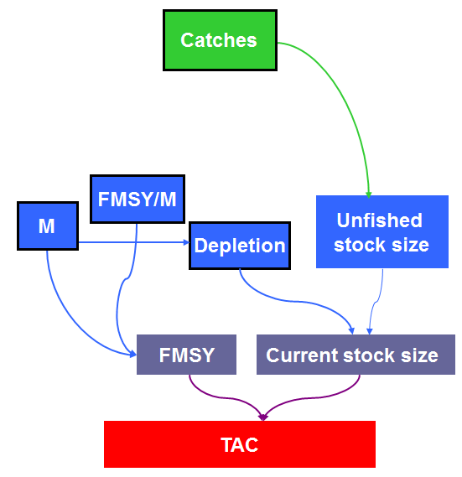
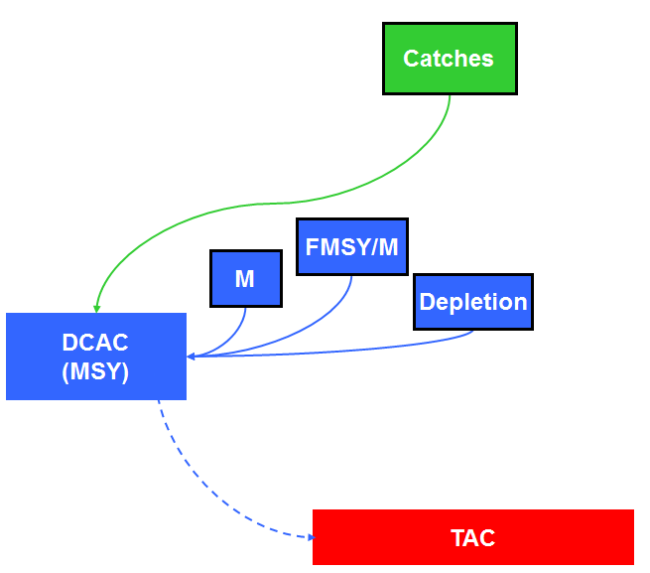
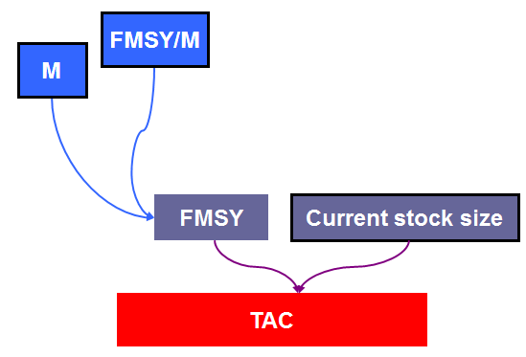
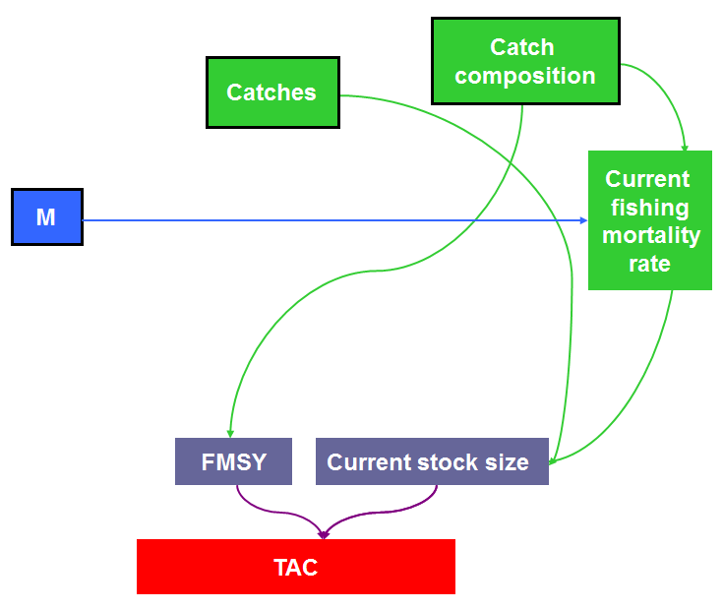
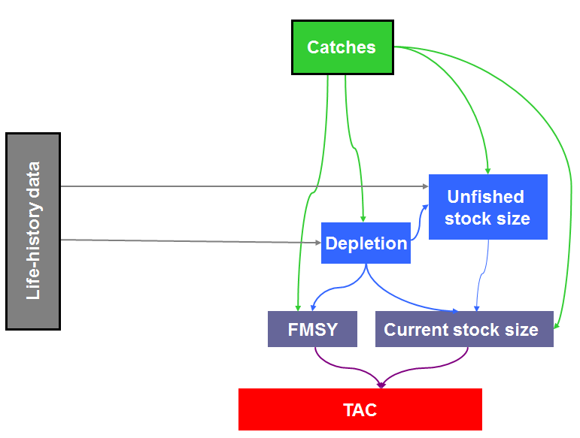
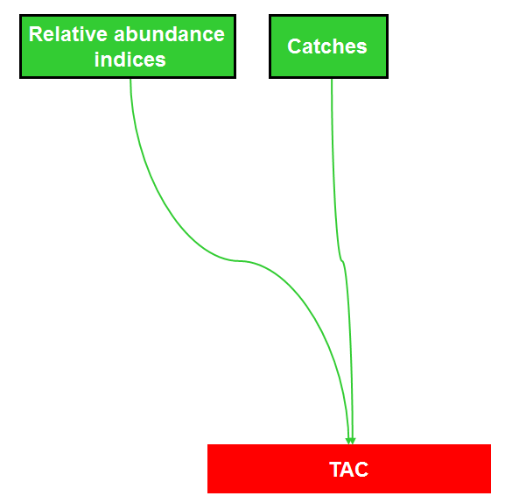
Data – TAC pathways
DBSRA
DCAC
Fratio
SPMSY
YPR_ML
Itarget1

Slide 24
Summary
An MP (as defined here) is any algorithm that gets you from data to a management recommendation
There are a very large number of possible MPs that range from the simple to the complex
MPs use varying types of data and interpret these in varying ways
As long as the required input data can be generated, an MP can be tested using MSE

Slide 25
References
Costello, C. et al. 2012.Status and solutions for the world’s unassessed fisheries. Science 338, 517–520.
Nakatsuka, S. 2016. Management strategy evaluation in regional fisheries management organizations − How to promote robust fisheries management in international settings. Fisheries Research. DOI: 10.1016/j.fishres.2016.11.018
Punt, A.E., et al. 2016.Management strategy evaluation: best practices. Fish Fish. 17, 303–334, http://dx.doi.org/10.1111/faf.12104.
SEDAR, 2015. SEDAR 46: U.S. Caribbean Data-Limited Species. SouthEast Data, Assessment, and Review (SEDAR) 23. http://sedarweb.org/sedar-46.
SEDAR, 2016. Stock assessment report: Gulf of Mexico Data-limited species. Gulf of Mexico Fishery Management Council. SEDAR 49. http://sedarweb.org/sedar-49-final-stock-assessment-report-gulf-mexico-data-limited-species.

